Slide 1
Rainforest deforestation
Leah Camilletti, Katia Voloshin
Brady Springer, Weston Brady

Slide 2
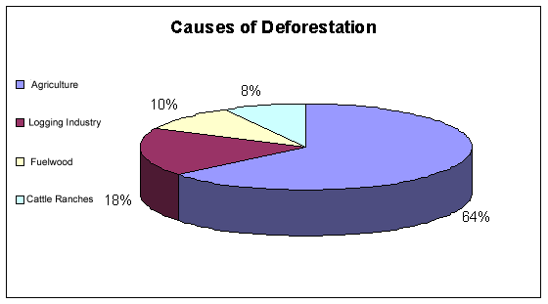
Definition-
Deforestation is when you cut or burn down trees in the rainforest.
People do this because they need the land for farming and agriculture pastures.

Slide 3
What the people can do
Recycle paper
Protest against it
Plant more trees where others were cut down

Slide 4
It is important to know about Rainforest Deforestation because:
Destroys animal habitat
Erosion
Change in climate
Plants and trees die out

Slide 5
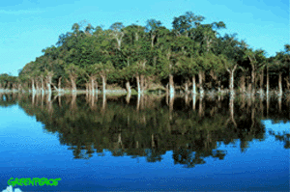
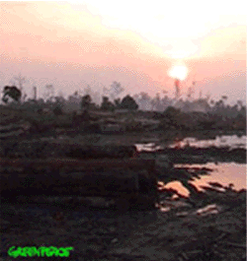
This is before deforestation
After deforestation

Slide 6
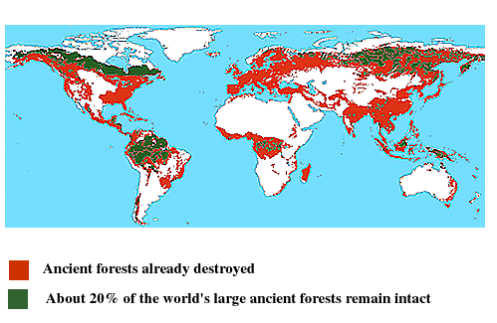

Slide 7
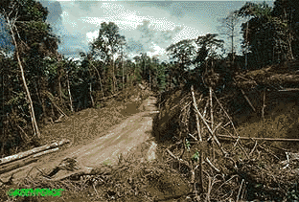
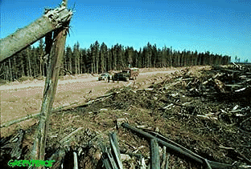
A typical logging road in a rainforest
Another logging road

Slide 8
Rainforest deforestation can impact our environment in many major ways.

