Slide 1
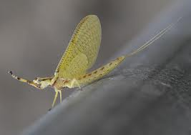
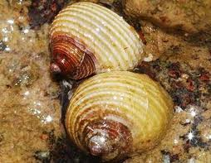
STANDING WATERS: Insects and Molluscs

Slide 2
Aquatic Insects
WHAT ARE INSECTS?
Insects are the most successful group of animals on earth.
Over 1 million species of insects have been identified.
Insects have been classified into 30 different orders.
11 orders are aquatic insects.
We are going to talk about 9 of these orders.

Slide 3
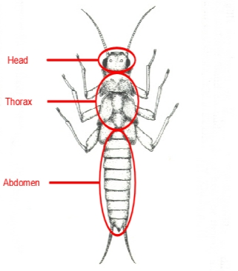
INSECT BODY PARTS
Adult Aquatic Insects have special head, thorax, and abdomen regions. The thorax
has 3 segments, each bearing a pair of legs. The wings are also on the thorax, and some insects have 2-1 pairs of wings or none.

Slide 4
Main Orders Of Aquatic Insects
Name of order | Examples
Diptera | Midge flies, mosquitoes
Odonata | Dragonflies, damselfly
Plecoptera | stoneflies
Ephemeroptera | mayflies
Trichoptera | caddisflies
Megaloptera | Dobsonflies, alderflies, fishflies
Hemiptera | True bugs
Coleoptera | Beetles
Collembola | springtails
Notes:
Have students copy the table, pg. 141 and take notes throughout the presentation.

Slide 5
Adaptations of how Aquatic Insects breathe.
All insects have a tracheal breathing system, w/ air traveling through the tracheae to each cell. In adult terrestrial insects the tracheae are connected to pores called spiracles. Here are ways air gets to the spiracles under water:
Some adult beetles and bugs come to the surface to exchange gases.
Notes:
Will use these adaptations later.

Slide 6
Adaptations continued
Some adult bugs/beetles form air bubbles under their wings/hairs and are placed over spiracles. Each bubble acts like a lung. Oxygen goes in the bubble from the water and then into the spiracles. Carbon dioxide comes out and into the water. The bubble doesn’t need to be replaced if the insect is inactive for hours, or even days
The larvas of some diptera use a siphon. They come to the surface, put it above the water, and breathe.

Slide 7
Adaptations continued
Many larvas have no spiracles. Gas exchange w/ the water occurs through the body surface, so they don’t have to come to the surface of the water.
Many larvas have gills, and are just thin extensions of the body surface to make the gas exchange easier as described above.

Slide 8
Insects: The True Flies
Make up the order of Diptera.
16,500 total species, 2,000 have larval stages that are aquatic.
The adults are never aquatic.
Here are seven of these families.

Slide 9
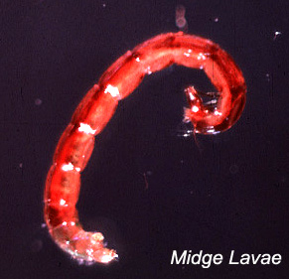
Midge Flies (Family Chironomidae)
↗
↙
cockburn.wa.gov.au
Has about 2,000 species.
Herbivores and scavengers
Notes:
The adults are about 5 mm long, larva 2-30 mm long. They have a pair of prolegs on the first segment of the thorax and on the last of the abdomen. Larva vary in color from white, yellow, and pink to a deep red. That’s why it is called a bloodworm.

Slide 10
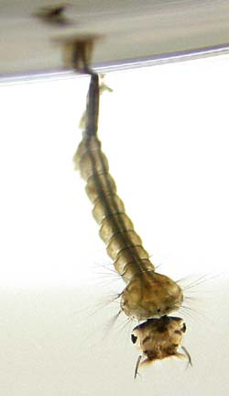
Mosquitoes (Family Culicidae)
Both the pupa and the larva use siphons to breathe.
Do not depend on dissolved oxygen at all.
Eat on protozoans, algae, and tiny pieces of detritus.
↗
landcareresearch.co.nz
Notes:
The larva, as in the picture, hang from the surface and when its disturbed, they move to the bottom and back to the top w/ a wriggling motion. They are called wrigglers. The pupas move by tumbling head over heels. They’re called tumblers. They can live in stagnant water w/out dissolved oxygen and prefer/thrive to live there because mostly the predators are gone.

Slide 11
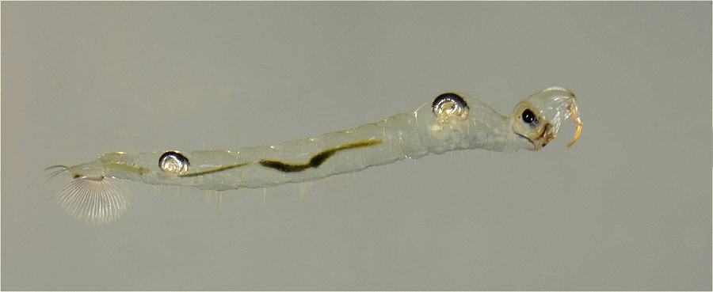
Phantom Midges (Family Culicidae)
↓
↓
scutigera.deviantart.com
Common in most lakes and large ponds.
Carnivores
Notes:
Except for 2 silvery sacs that help them move up and down in the water, the larva of the phantom midge is transparent. They swim w/ a jerky, lashing movement, and prey on small insects and crustaceans, using their antennas.

Slide 12
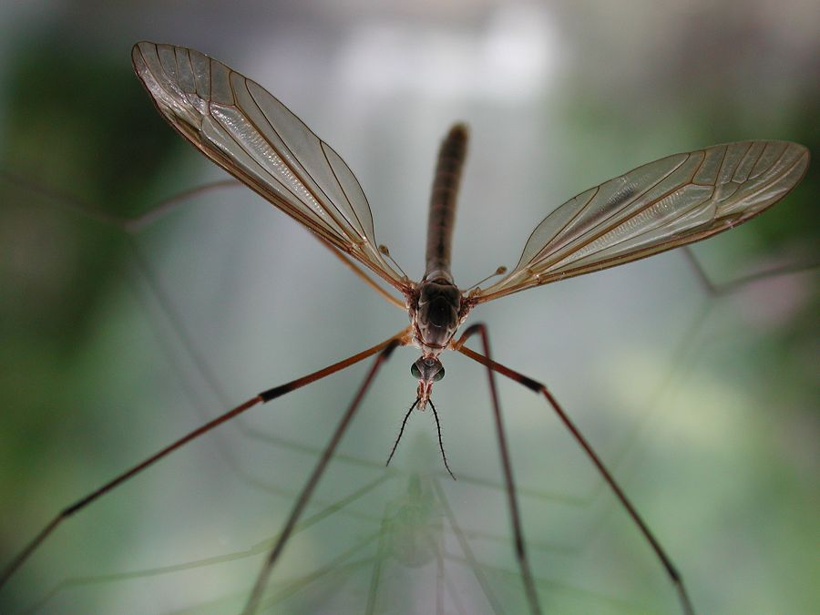
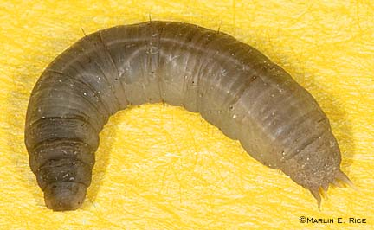
Crane Flies (Family Tipulidae)
Adults
fcps.edu
↖
Larva
Adults look like giant mosquitoes.
Larva look like fat worms.
Both Herbivores and Carnivores.
Notes:
The Crane Fly larva range in color from white to brown and are found in most aquatic habitats, including standing waters. The anal end bears fingerlike gills and a pair of spiracles. These are pushed into the air when dissolved oxygen is low.

Slide 13
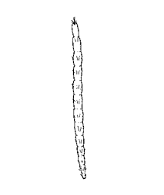
Biting Midges (Family Heleidae)
Adults are usually under 4 mm long.
Larva are from 3-12 mm long.
Some species are carnivores, herbivores, or even cannibalistic.
waterwatchadelaide.net.au
Notes:
Adult Biting Midges are flies. Even though you can feel them bite you, you can’t see them, so they’re called “no-see-ums”. The larva are found in most aquatic ecosystems, but are most abundant in floating masses of algae.

Slide 14
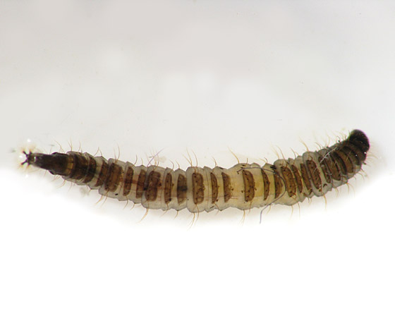
Moth Flies (Family Psychodidae)
Adult flies are less than 4 mm long.
Larva are 3-10 mm long.
Feed on algae and decaying plant material.
bugguide.net
Notes:
Moth flies are the flies that gather around the lights at night, and have hairy bodies. The larva are very common in stagnant water and even in sewage water. They can live in stagnant water because they move to the top and breathe through siphons. They are a grayish color.

Slide 15
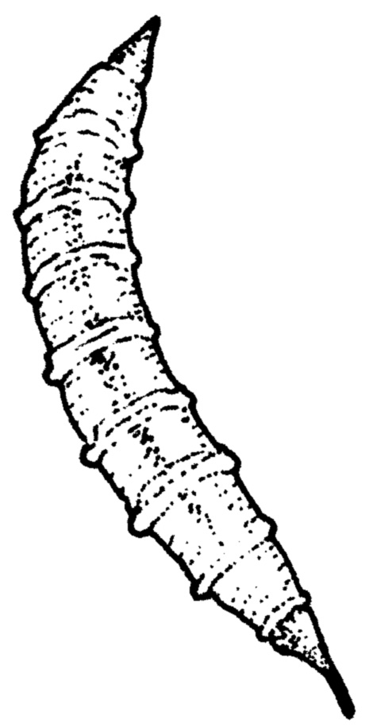
Horseflies (Family Tabanidae)
MAJOR PEST!!!!!
Adult flies are 15-40 mm long.
Larva are 15-40 mm long.
Feed on detritus, and some species are carnivorous also.
clean-water.uwex.edu
Notes:
The larva don’t bite like their older selves. They are found on the bottoms of ponds, shallow lakes, swamps, and pools, and some species live in flowing waters. The larva can be white, green, brown, or yellow, and are tapered at both ends. The anal end has a short siphon.

Slide 16
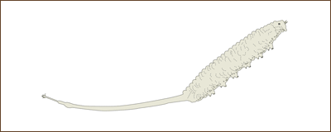
Hover Flies (Family Syrphidae)
ah.novartis.com
Also called flower flies and bee flies.
Larva are from 5-25 mm long.
Notes:
These colorful flies are often found around flowers and hover in one place in the air for many seconds, therefore the name comes in as hover flies. The larva of the hover fly, Eristalsis, have an extremely long siphon that telescopes out like a radio antenna. Eristalsis larva are somewhat inactive. They feed on detritus in shallow water. They are also called “rat-tailed maggots”.

Slide 17
Insects: The Other Flies
Several orders have the name “fly” but aren’t true flies. (2-winged or Diptera)
4 of these orders have members that live in standing waters:
Mayflies
Caddisflies
Dragonflies and Damselflies
Alderflies, Dobsonflies, Fishflies

Slide 18
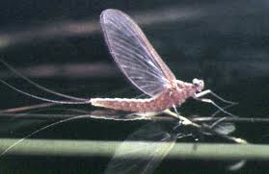
Mayflies (Order Ephemeroptera)
Adults live for only just a few hours or days. Don’t eat.
Nymphs are classified in three groups according to their habitats:
Bottom Sprawlers
Vegetation Dwellers
Burrowers
Are called opportunistic feeders, will eat what ever comes their way.
vro.dpi.vic.gov.au
Notes:
The majority of the Mayfly life cycle is spent in the stage of the nymph. The nymphs occur in all kinds of freshwater ecosystems, if there is oxygen at about 5 micro grams per gram. But some species can live w/ 2 μg/g.

Slide 19
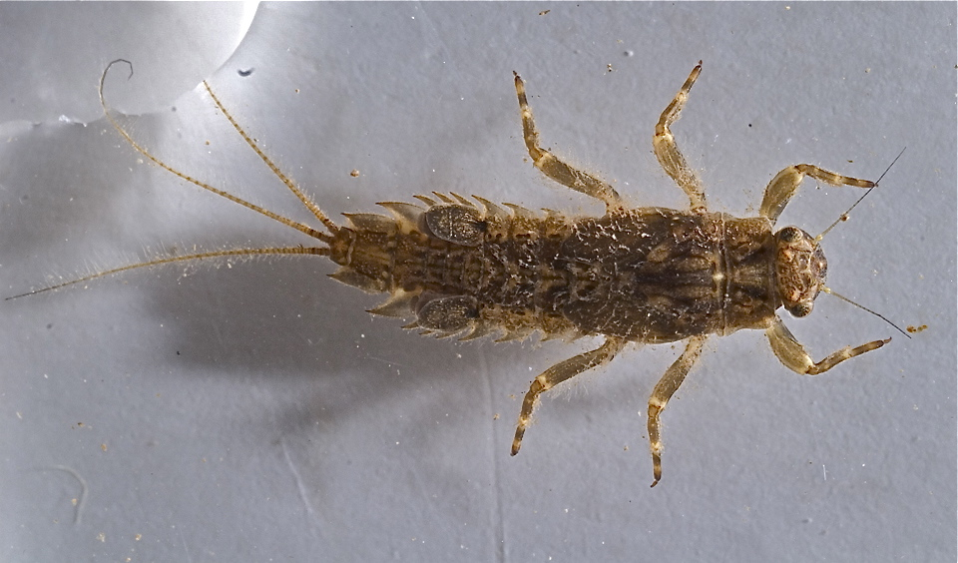
Bottom Sprawlers
Crawl on bottom of lake/pond.
Covered in detritus.
↓
↑
aquaticinsectsofcentralvirginia.blogspot.com
Notes:
These bottom crawlers have large gills on their abdomen adapted to protect the lower, more fragile gills underneath from silting up in the murky, slow moving waters that they live in.

Slide 20
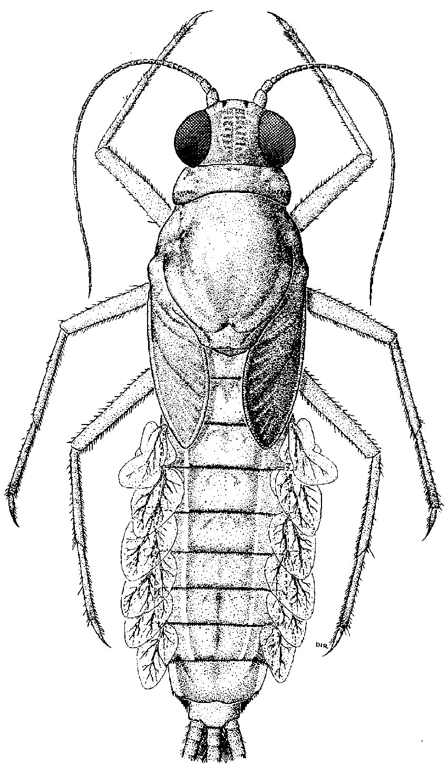
Vegetation Dwellers
Strong plate like gills and tails move the nymph through the water.
bioteaching.wordpress.com
Notes:
This type of mayfly nymph is adapted for running, swimming, and climbing throughout the submerged vegetation.

Slide 21
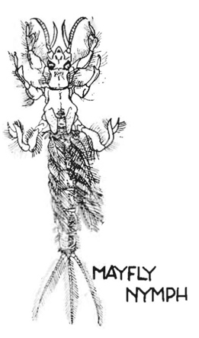
Burrowers
Spend time burrowing like moles through bottom material.
emporia.edu
Notes:
Since these burrowers spend time in the ground, they live in an oxygen deficient environment. They have adapted to this with large gills that flutter in the water to get extra oxygen. They also have an adapted jaw and muscular legs for burrowing.

Slide 22
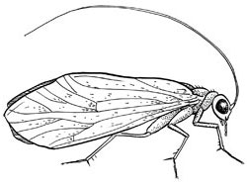
Caddisflies (Order Trichoptera)
biokeys.berkeley.edu
Adults look like small moths.
Black, gray, or tan in color.
Live no more than a month.
Larva are in most freshwater habitats.
Notes:
Adult caddisflies are nocturnal and live no more than a month. The larva on the other hand live from 6 months to a year. These larvas have adapted to their habitats by building cases from leaves, gravel, sand, bark, twigs, grass, and other debris. They live in their cases and carry them around w/ them too. Caddisfly larvas need a minimum 4 µg/g of oxygen, and make a waving action w/ their abdomens to get oxygen from the water into their cases.

Slide 23
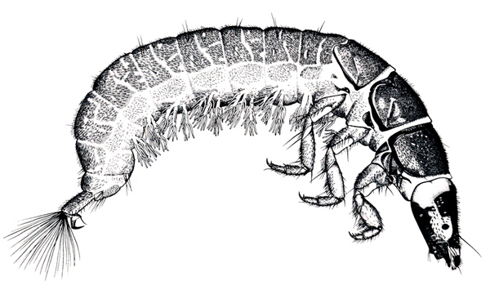
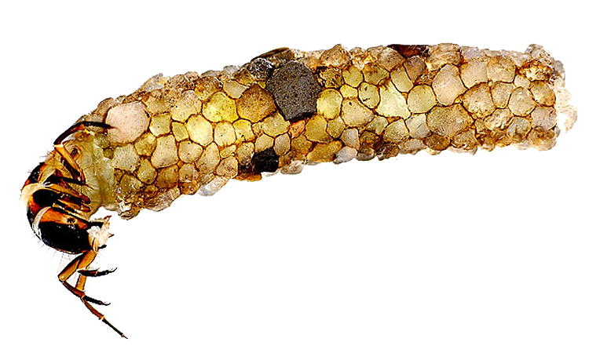
Caddisflies continued
Many different species feed on different things:
Grazers
Carnivores
Suspension feeders
Scrapers
Net Filter feeders
extension.entm.purdue.edu
visionarydigital.com
Notes:
Grazers feed on detritus, fungi, algae, and small invertebrates. Carnivores eat on worms, small insect larva, and small crustaceans. Suspension feeders filter algae, zooplankton, and small pieces of detritus from the water w/ hairs around the mouth and legs. Scrapers eat the same things as grazers but have adapted mouthparts for scraping it off the bottom of the material. Net filter feeders build nets to filter algae, zooplankton, and detritus from the water.

Slide 24
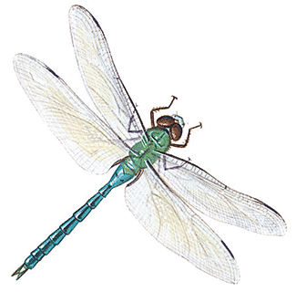
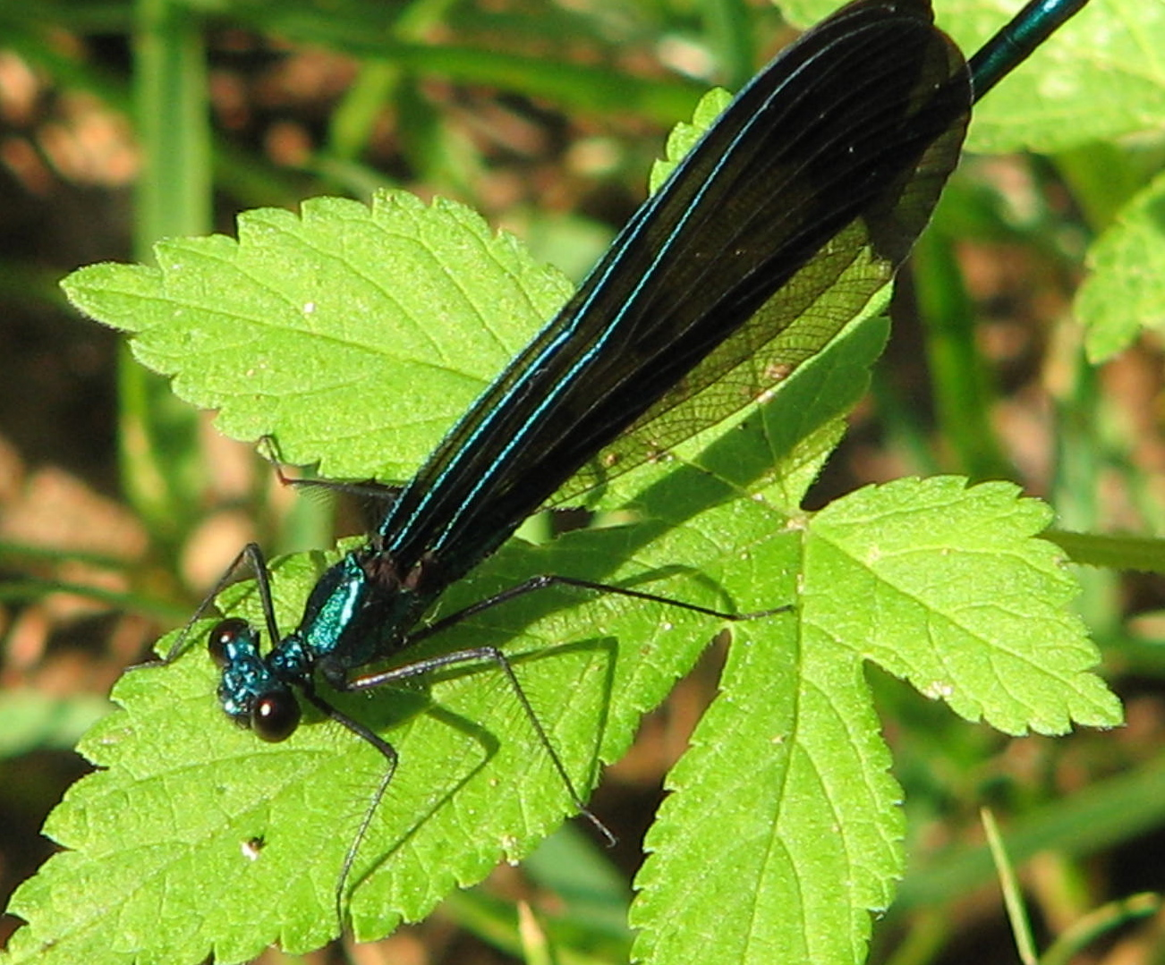
Dragonflies and Damselflies (Order Odonata)
Dragonfly
Damselfly is smaller, more delicate, and fly slower than a Dragonfly.
Dragonflies hold wings horizontal when land, Damselflies’ fold in.
Dragonfly nymphs are 15-45 mm long.
Damselfly nymphs are 10-20 mm long.
animals.howstuffworks.com
Damselfly
thefrugallife.com
Notes:
Odonata nymphs spend a year in the nymph stage before merging into adults. Like Mayflies, they can be classified as vegetation dwellers, bottom sprawlers, or burrowers, with about the same adaptations. Odonata are also carnivores

Slide 25
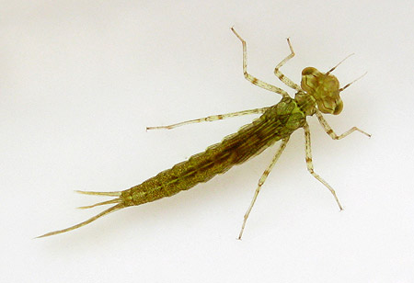
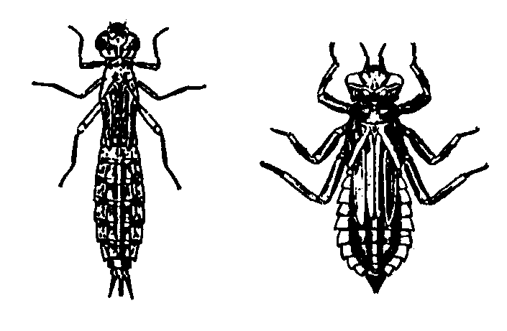
Order Odonata continued
Damselfly
All Odonata nymphs are adapted for being carnivores.
Feed on insects like mosquito larvas and pupas, worms, snails, and small crustaceans.
Need a moderate amount of oxygen in the water.
flyfishingthings.com
Dragonfly
state.ky.us
Notes:
Odonata nymphs sit in wait covered w/ debris until their prey comes near. Then the special mouthpart unfolds, shoots forward, and clenches the prey w/ 2 spikes to be eaten. The dragonfly nymph also has a large chamber in its abdomen, pulsing up and down, forcing water in and out of the chamber. It also contains gills inside which extracts oxygen from the water. But a Damselfly nymph breathes through their tail-like gills.

Slide 26
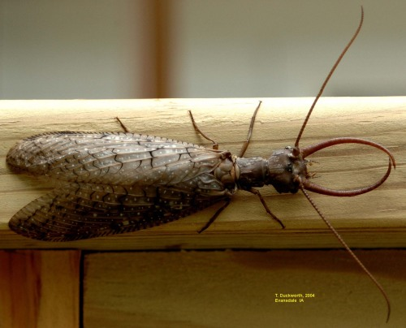
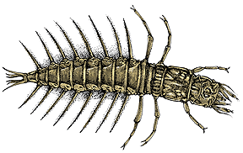
Dobsonflies, Alderflies, and Fishflies (Order Megalopera)
Dobsonfly male
ipm.iastate.edu
Larva
fishandboat.com
This order is split into 2 families:
Alderflies
Dobsonflies and fishflies
Larvas live for 2-3 years.
Notes:
The order Megaloptera larvas are similar in shape and size. They live along the bottom of ponds, lakes, and between stones in streams. All are predators that purse their prey all the time. Insect larvas are their favorite food. The large Dobsonfly larva called hellgrammites (in the picture) are used for live bait.

Slide 27
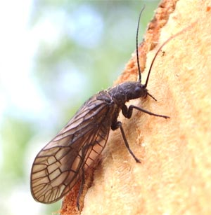
Alderflies
radleyvillage.org.uk
Black, brown, or orange
Adults are 10-15 mm long
Diurnal
Larva can get to be 25 mm long

Slide 28
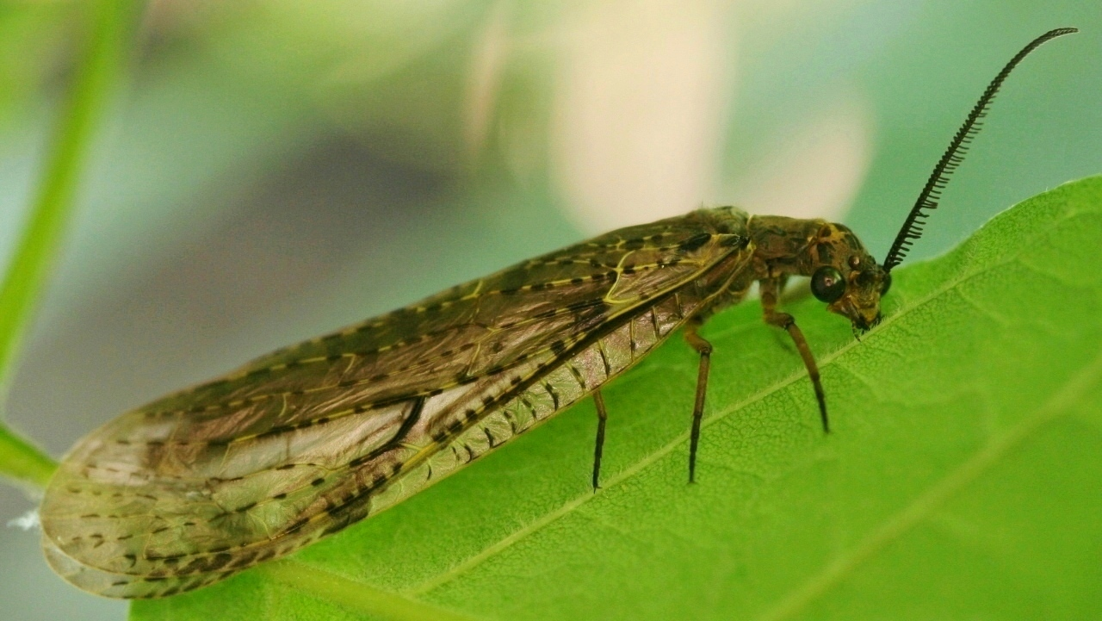
Dobsonflies and fishflies
Fishfly
dpughphoto.com
Black, gray, or brown
Adults are 40-75 mm long
Nocturnal
Larva can get up to 65 mm long

Slide 29
Insects: Bugs, Beetles, and Springtails
Three orders of insects:
The True Bugs
The Beetles
The Springtails.

Slide 30
The True Bugs (Order Hemiptera)
Bugs differ from other insects in 2 ways:
The mouthparts form a beak which is used to pierce the prey and suck the fluids out.
The forewings are thick at the base instead of being membranous throughout (as other insects wings are).
Most all are Predators, feeding on aquatic insect larva.

Slide 31
Water Stider
Skates and jumps on the surface of the water.
Have waxy hairs on the tips of their legs.
Eats aquatic insects
Notes:
The water strider is a well-known bug, that skates on the water. It has waxy hairs on the tips of the legs that make it possible to walk on the water.

Slide 32
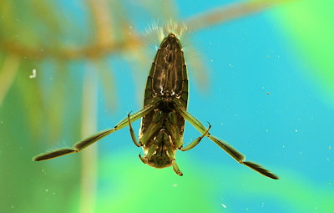
The Backswimmer
Backswimmer swims on its back (duh).
Also has habitat of hanging upside down.
flycraftangling.com
Notes:
The Backswimmer is an odd insect of the true bugs. When it dives down it traps air with it. The air then goes in 2 troughs on the lower side of the abdomen. They may bite you if you get too close.

Slide 33
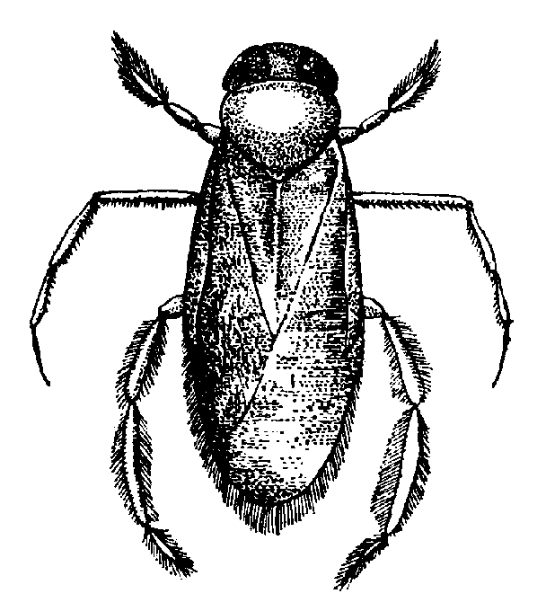
Water Boatman
The most common water bugs
Spend most time in submerged vegetation.
Feed on small crustaceans, rotifers, protozoans, plankton, and also suck the juices out of filamentous algae.
thedragonflywoman.com
Notes:
The Water Boatman is the most common kind of true bugs. When they dive, they bring with them a film of air that covers their entire bodies. Air is also held under their wings and acts like a lung as described before. If it isn’t active it doesn’t have to come to the surface of the water. Most are strong fliers.

Slide 34
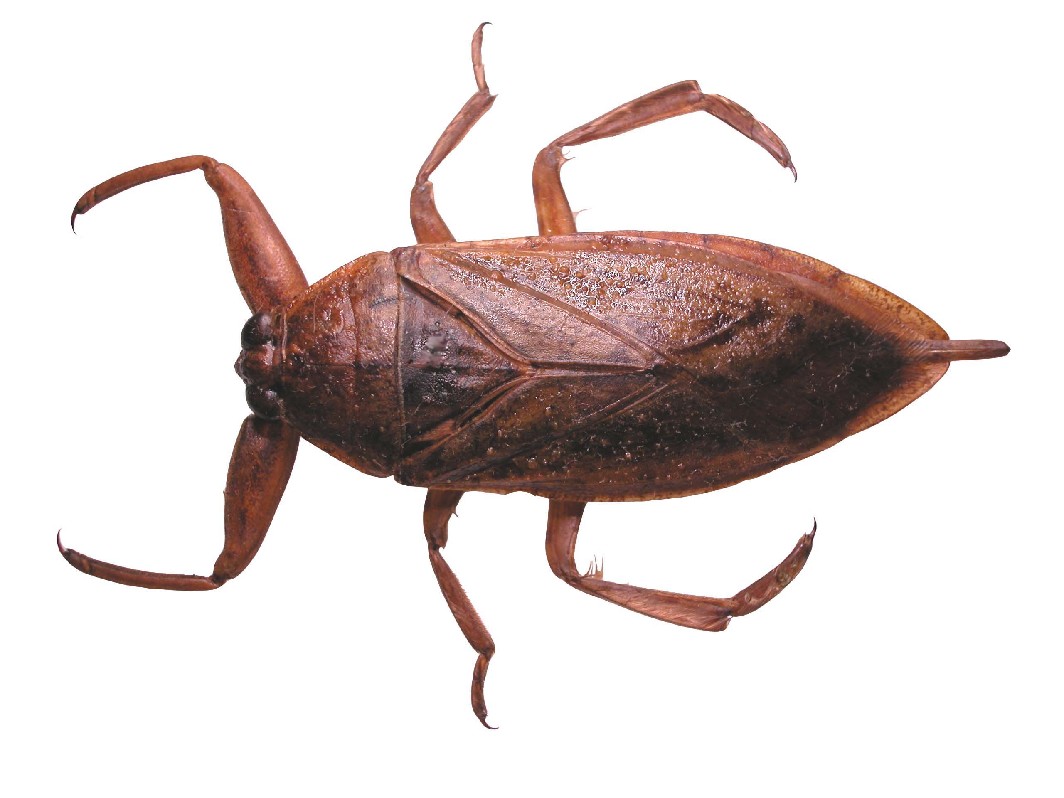
Giant Water Bug
calicat.tripod.com
Reaches 70 mm in length and 25 mm in width!!!!
Largest of the bugs.
Feed on insect larvas, tadpoles, small frogs, and even small fish.
Notes:
The Giant Water Bug is the absolute biggest bug of all. It lives on the bottom of shallow ponds and in the littoral zones in lakes. These also take an air bubble w/ them when they dive. They are fierce predators and also fly. Becareful when you pick one up because they have a toxin in its beak as it bites.

Slide 35
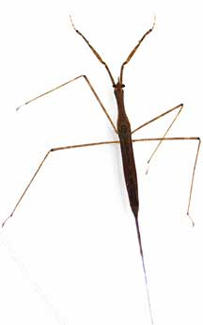
Water Scorpion
whatsthatbug.com
Hangs upside down in vegetation close to the surface.
2 filaments used for breathing.
Front legs adapted for catching prey.
Blend in well.
Seldom fly
Notes:
The water scorpion is hard to find because of a stick like shape and color. It has 2 filaments that look like tails and are brought out of the water to breathe. They’re always in the ready and catch up insect larvas.

Slide 36
The Beetles (Order Coleoptera)
Largest order of insects w/ over 250,000 species world wide, 30,000 in US and Canada.
Few are aquatic
All have 2 pair of wings.
Forewings are hard instead of membranous and protect other wings.
We’ll talk about 3 families.

Slide 37
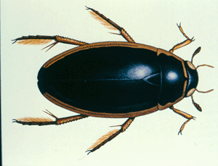
Predaceous Diving Beetle
Very active predator both as adult and larva.
Feed on insect larvas, tadpoles, and fish.
Live on submerged vegetation in clean ponds and lakes.
bioweb.uwlax.edu
Notes:
These beetle are predators attacking everything in sight, even one another. Some species have jaws of the larvas bigger than their head.

Slide 38
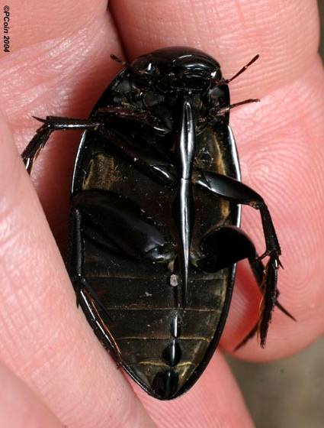
Water Scavenger Beetle
Common in shallow ponds where there is much submerged vegetation.
Most crawl, but some swim.
All adults fly though.
Feed on decaying vegetation, dead animals, and sometimes living plants and insect larvas.
bugguide.net
Notes:
This beetle looks a lot like the predaceous diving beetle, but if you turn it over it has a spine between its legs. These beetles also take an air bubble w/ them when they dive.

Slide 39
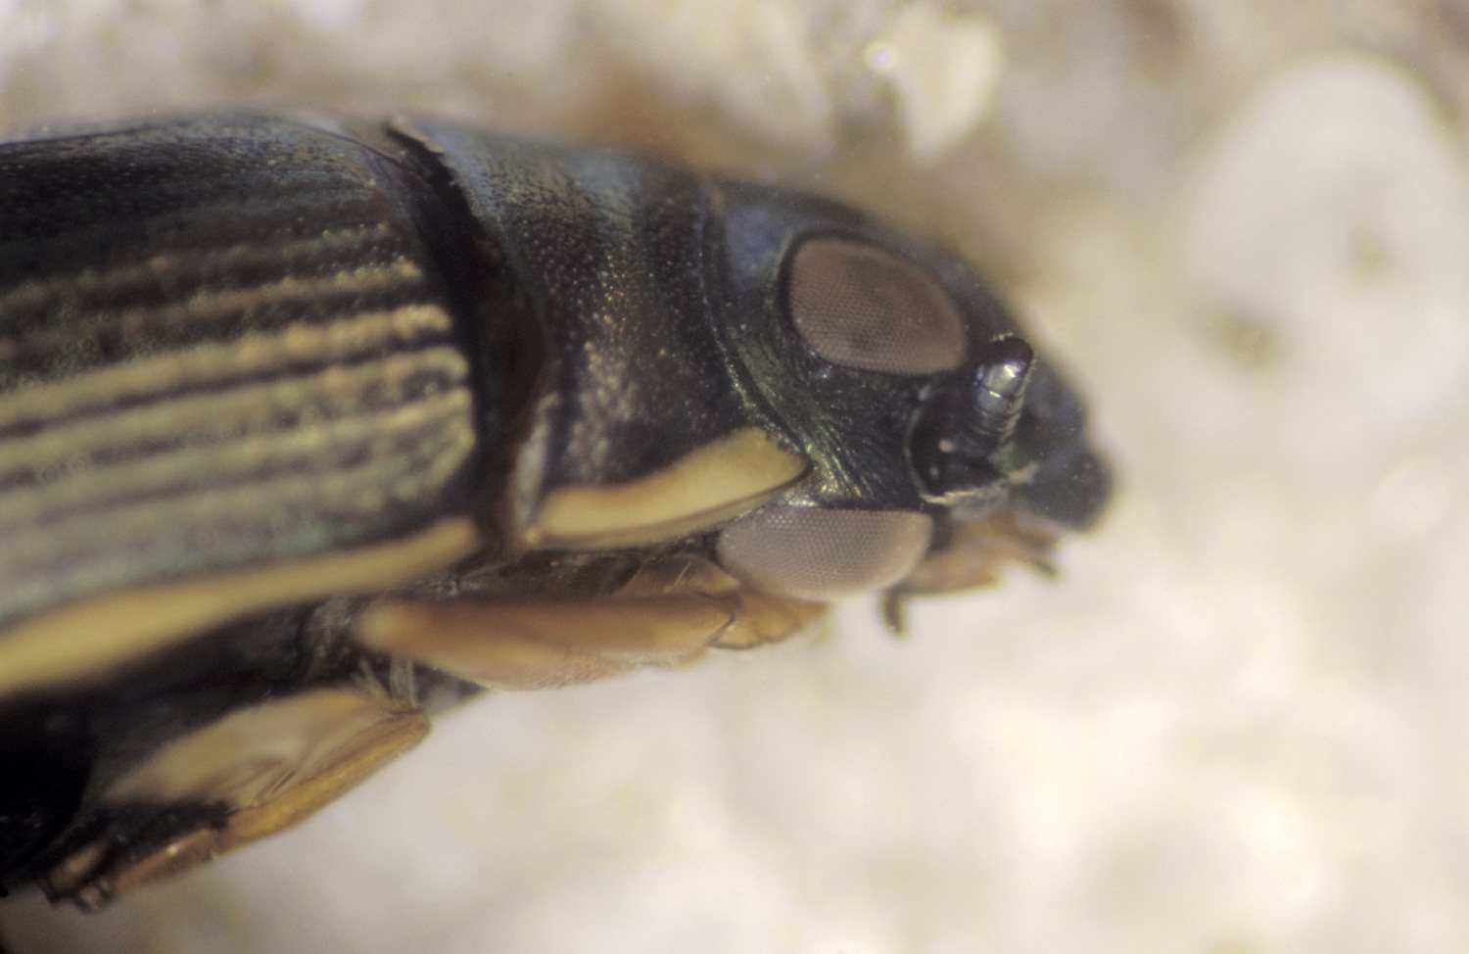
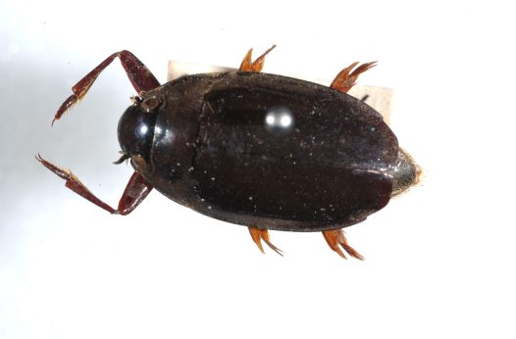
Whirligig Beetles
↓
Often occur in large colonies.
Scatter and dive when alarmed.
Sparkle because of air bubble they carry underwater.
Feed on live insects, and dead animal and plant matter as scavengers.
↑
biodiversitysnapshots.net.au
australianmuseum.net.au
Notes:
Whirligig Beetles glide around on the surface of the water. They also have an unusual adaptation. Their eyes are divided into 2. One half looks up into the sky while the other looks into the water. These beetles can fly, but have to crawl out of the water to take off.

Slide 40
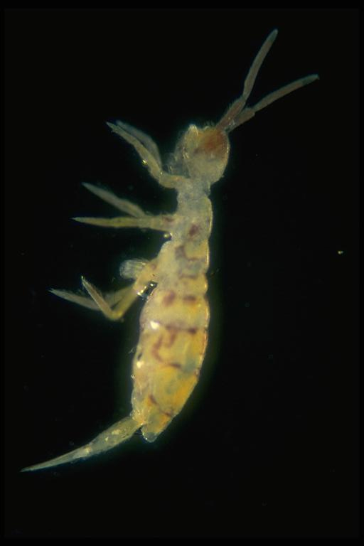
The Springtails (Order Collembola)
3 to 4 mm long, but can jump over 30 cm through the air!!!!!!
Although, they aren’t aquatic.
Feed on algae, fungi, plants and plant detritus, sometimes dead crustaceans, worms, snails and protozoans.
↗
insects.tamu.edu
Notes:
The Springtail didn’t just get its name from any where, when it snaps its tail downward in the water it soars about 30 cm through the air. They live on the surface of quiet areas of lakes, ponds, and marshes. They are most common in the spring and fall time.

Slide 41
The Molluscs
Phylum Mollusca has 75,000 species.
Second largest phylum of animals.
Two classes have important freshwater members:
Snails and Limpets
Clams and Mussels
Most occur in saltwater habitats.
Among molluscs are clams, snails, whelks, conchs, oysters, and octopuses.
All have soft body which is often in a shell.
All have a “foot” on underside used for burrowing, crawling, of swimming.

Slide 42
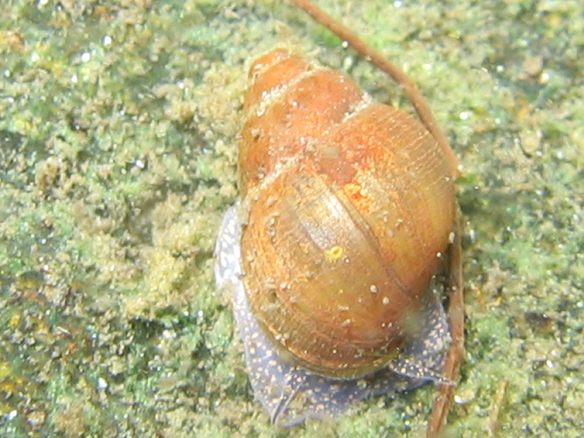
Snails and Limpets (Class Gastropoda)
Are univalve molluscs
Snails have one spiral or coiled shell and need moderately high oxygen levels.
Limpets have one shell in the form of a low cone and need high amounts of oxygen.
Rarely found in soft water or true sphagnum bogs because of acid.
Almost all freshwater ecosystems contain snails and limpets.
Herbivores, feed on algae on rocks, logs, etc., and dead plants and animals.
hubbardbrook.org
Notes:
Snails and Limpets are found almost in all freshwater habitats except for badly polluted water, very cold mountain lakes, and very salty prairie sloughs. Snails and Limpets live in hard water because they need calcium to build their shells and soft water doesn’t have it. Hard water is also basic and that’s what they prefer. Occur in water less than 3 m deep.

Slide 43
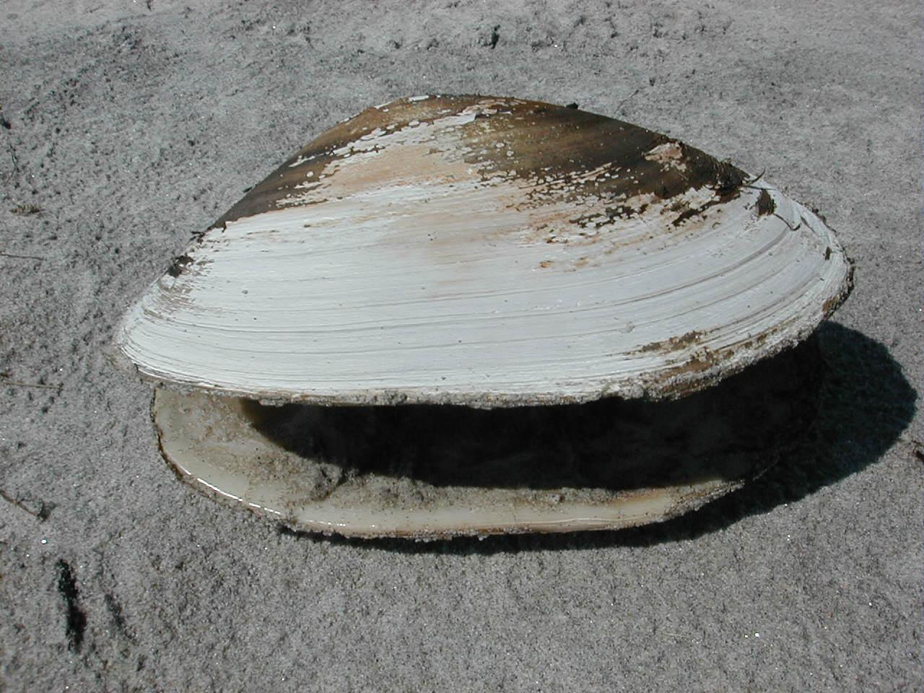
Clams and Mussels (Class Plecypoda)
Are bivalve molluscs, have two shells, or valves, hinged together.
Occur in most all freshwater systems.
Most abundant in large rivers, and common in wave swept lakes.
Omnivores, feed on phytoplankton (algae), small parts of detritus, and zooplankton.
frontporchrepublic.com
Notes:
Clams and mussels are again almost found in all freshwater ecosystems, but are never in polluted water and prefer less than 2 m deep water. They tend to choose stable bottoms such as mud or gravel, but not sand. Unlike other molluscs, they have no head. Like the univalves, they like basic water and need the same conditions for shell building.

Slide 44
Video
http://www.youtube.com/watch?v=gucYpd4xM9c

Slide 45
Thank you for your time!!!
(sorry it was sooooo lonnngg!!!!)

