Slide 1
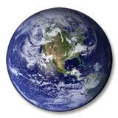
Global Warming
By: Emily white
Taylor Oxenreider
Makayla True

Slide 2
What is Global Warming?
Global Warming is the increase of the average temperature on the earths surface. Green house gasses traps the suns heat in our atmosphere heating the surface.
Which is caused by green house gasses, the amount of green house gasses have rapidly increased since the start of burning fossil fuels.

Slide 3
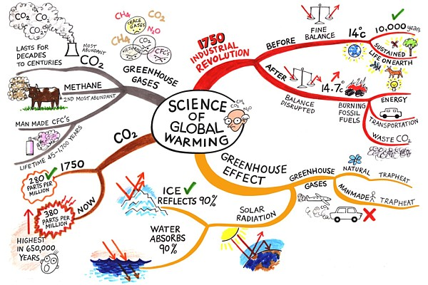
Why should we be aware of global warming?
People are not aware how serious this is. according to NASA the earths average temperature has increased .7 to 1.4 degrees in 100 years By 2100 the average temperature will rise an additional 2.5 to 10.4 degrees F.
We cause it by burning fossil fuels. we need to be more aware of how much pollution we are releasing into the air
global warming may not affect you now but in some years the damage can be irreversible.
Global warming has a negative impact on human health

Slide 4
What we can do about Global warming
one thing we can do is reduce reuse and recycle
Use less heat and conditioning
Change to CFL bulbs
Drive less and drive smart
By energy efficient products
Plant trees
Use less hot water
Encourage others to conserve

