Slide 1
Garbage
By: Trevor Johnson, Joelle Castle, Brittany Barrientez, Trace Fallon

Slide 2
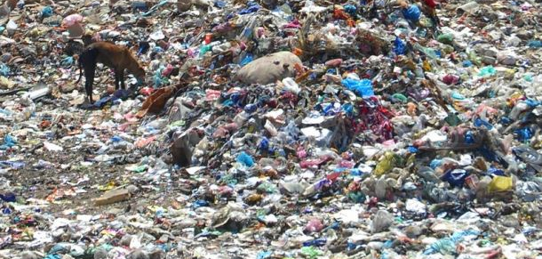
Dumps

Slide 3
THROUGH THE YEARS

Slide 4
Facts about garbage
The average American discards 4.34-5.00 pounds of garbage everyday.
When garbage decomposes in a landfill , it creates gas that contains methane, a reliable and renewable source of energy that if turned into energy, helps reduce greenhouse gas emissions, the high coast of energy, and our dependence on foreign oil.
40% of our trash is paper, 17.5% is yard waste, 8.5% is metals, 8% is plastic,7.5% is food waste, 7% is glass and 11.5% is everything else.
Sadly, only about 20% of what people do place into trash can to be picked up can’t be reused or recycled.

Slide 5
MORE GARBAGE FACTS!!!
For many landfill out there space has become an issue. There is no more area for them to continue placing new items
The total volume of solid waste produced in the us each year is equal to the weight of more the 5,600 Nimitz class air craft carriers 247,000 space shuttles or 2.3 million Boeing 747 jumbo jets.
If we put all of the solid waste collected in the US in a line of average garbage trucks, that line of trucks could cross the country, extending from New York city to Los Angeles, more than 100 times.

Slide 6
Recycling helps earth

Slide 7
Recycling
Recycling helps earth by taking some of the garbage away
Recycling one ton of paper saves 17 trees , two barrel of oils enough to run the average car for 1,260 , 4100 kilowatts of energy enough power for the average home for 6 months , 3.2 cubic yards of landfill space , and 60 pounds of pollution

