Slide 1
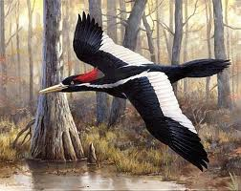
Endangered Animals
The ivory-billed wood pecker
By Chris Williamson , Miguel Meza , Ashley Leray

Slide 2
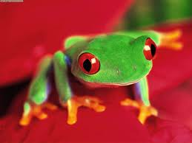
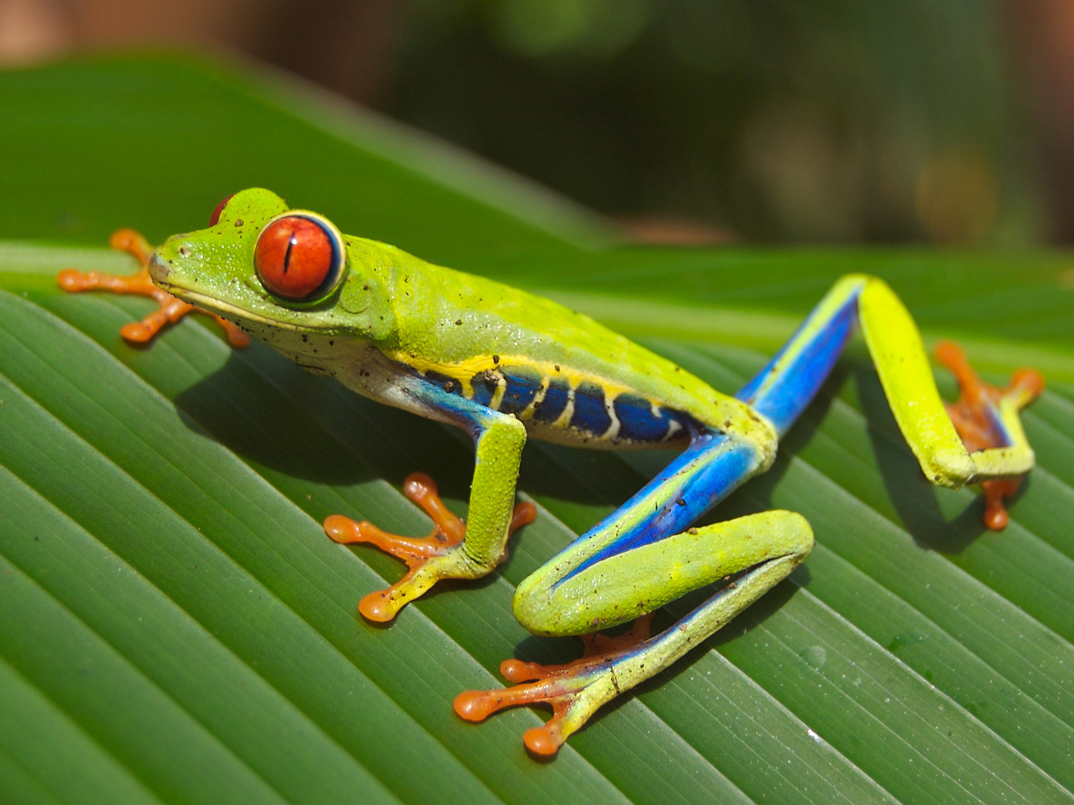
Endangered Animals
What are endangered animals?
A certain species that is in risk of extinction because of rapid population depletion or on the verge of vanishing from the Earth like Certain kinds of The Red Eyed Tree Frogs
The Red Eyed Tree Frog

Slide 3
Why is it important?
One animal can destroy an entire ecosystem causing holes in the food chain.
This could be devastating to other animals and make huge chain reactions harmful to our planet.

Slide 4
What can we do to help endangered animals?
Obey the law!
Learn from a local wildlife manager about the Endangered animals in your area

