Slide 1
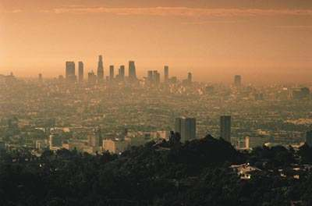
Air Quality Issues

Slide 2
What is air quality issues?

Slide 3
Where are air quality issues taking place?
In the 2007 issues the top nominees are China, India, Peru, Russia, Ukraine and Zambia.

Slide 4
Why are there air quality issues?
Chemicals and sulfates puff out of coal burning factories around the world.

